Slide 1


NetScanner - Automated Network
Enumeration and Vulnerability Analysis Tool
Guide
Dr J.Naskath, ASSO PROF/CSE
Team Members
MS S.Sarikha RegNo : 2212012 3rd Year CSE
Ms R.Sri Gomathi RegNo : 2212013 3rd Year CSE
MS S.Aruna Varshini RegNo : 2212019 3rd Year CSE
1
25/01/2025

Slide 2

CONTENT
Problem Statement
Introduction
Key Features
Workflow
Empathy map
Conclusion
2
25/01/2025

Slide 3
1. PROBLEM STATEMENT
Nmap is difficult for non-technical users: It’s complex and requires command-line knowledge.
Manual scanning is time-consuming and error-prone: Users need an easier, automated solution.
Need for a simple, user-friendly web tool: To make scanning and vulnerability detection more accessible.
Limited Customization: Users struggle to choose the right scan options.
No Scan History: Nmap doesn’t store past scan results for easy reference.
3
25/01/2025

Slide 4
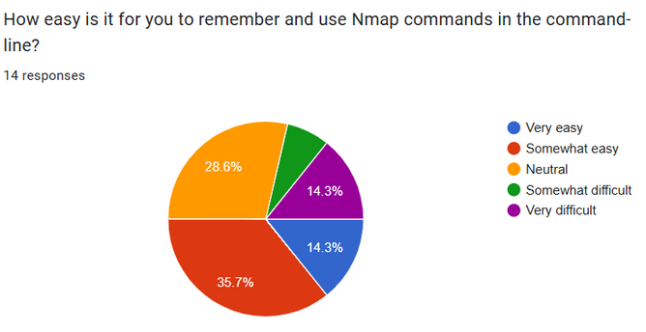
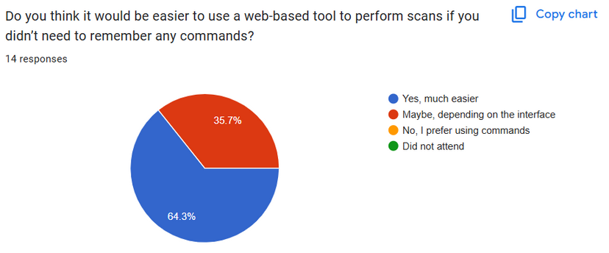
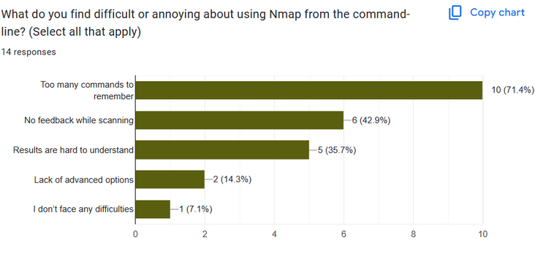
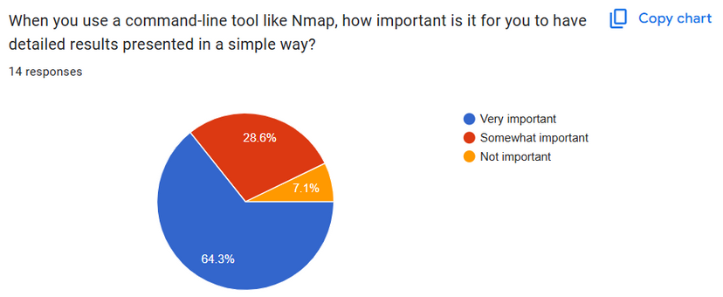
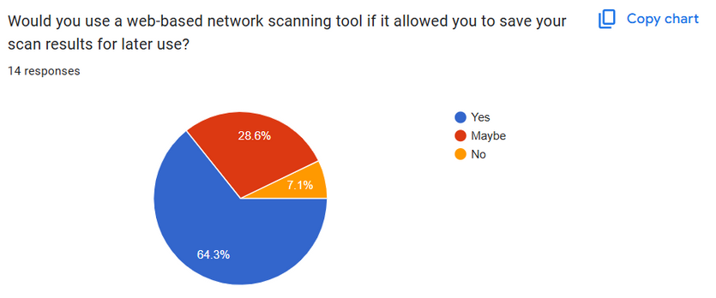
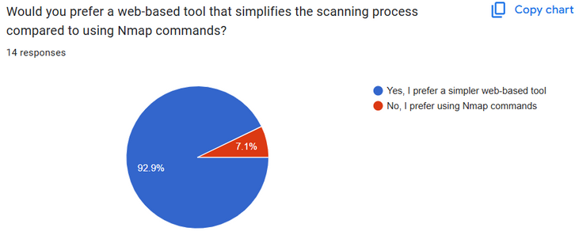
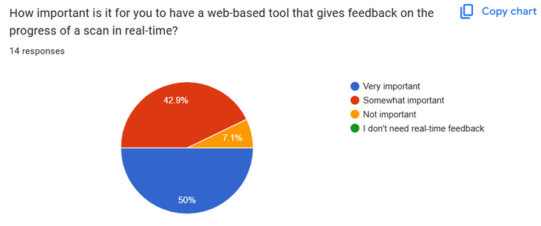
Fig 1.1.1
Fig 1.1.5
Fig 1.1.4
1.1 User Survey
Fig 1.1.2
Fig 1.1.6
12
25/01/2025
Fig 1.1.3
Fig 1.1.7

Slide 5
2.INTRODUCTION
Domain & Purpose:
Cybersecurity domain focused on network scanning and vulnerability analysis.
Aim to provide a user-friendly web-based platform for automating Nmap scans.
Solution Offered:
Automated Nmap Scanning: Users can input single IPs, IP ranges, or multiple IPs and choose scan options.
Easy-to-Understand Results: Scan results presented in a clear format for quick insights.
AI Chatbot: Provides real-time assistance and guidance, especially for vulnerabilities detected in scans.
Scan History & Report Generation: Stores past scan results for users and generates detailed reports.
Command Descriptions: Explanation of Nmap commands for better user understanding.
User Base:
Network Administrators and Cybersecurity Professionals who need to assess and monitor network security.
IT Specialists for identifying and fixing vulnerabilities.
Beginners or Non-Technical Users seeking an easy-to-use platform for running network scans.
Users needing fast access to network scanning results with minimal setup and efficient scanning
4
25/01/2025

Slide 6
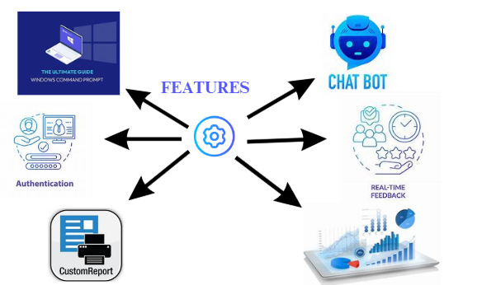
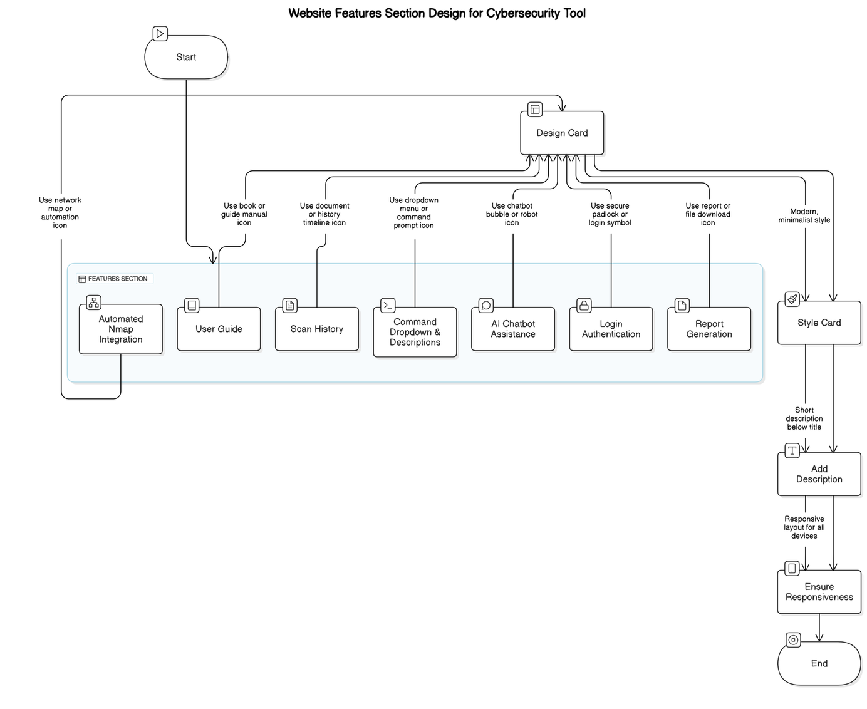
3.KEY FEATURES OF PRODUCT
IP Input: Users can enter a single IP or a range of IPs to scan.
Nmap Command Selection: Choose from basic or advanced Nmap commands for scanning.
Scan Execution: Automatically run Nmap scan after inputting IP and selecting a command.
Display Results: Show scan results with details like open ports and services.
Scan History: Store previous scans for easy access and future reference.
AI Chatbot: Provides vulnerability suggestions and answers questions based on scan results.
User Guide: Offers easy-to-follow instructions for using the tool.
Command Descriptions: Describes each Nmap command to help users understand what they’re running.
Report Generation: Generate and download scan reports in various formats.
Key Features
5
25/01/2025
Fig 3.1
Fig 3.2

Slide 7
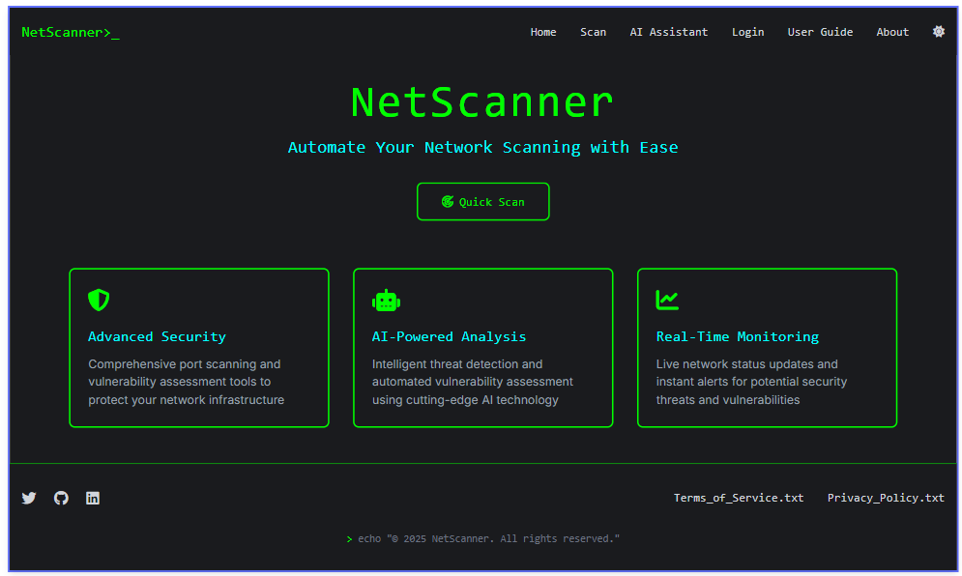
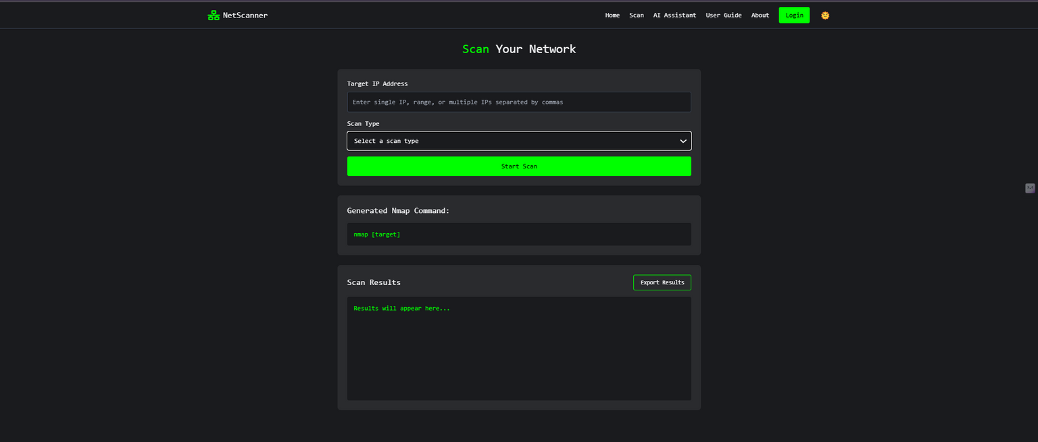
3.1 Visuals
Login Page
Scan Page
Fig 3.1.2
Fig 3.1.1
6
25/01/2025

Slide 8
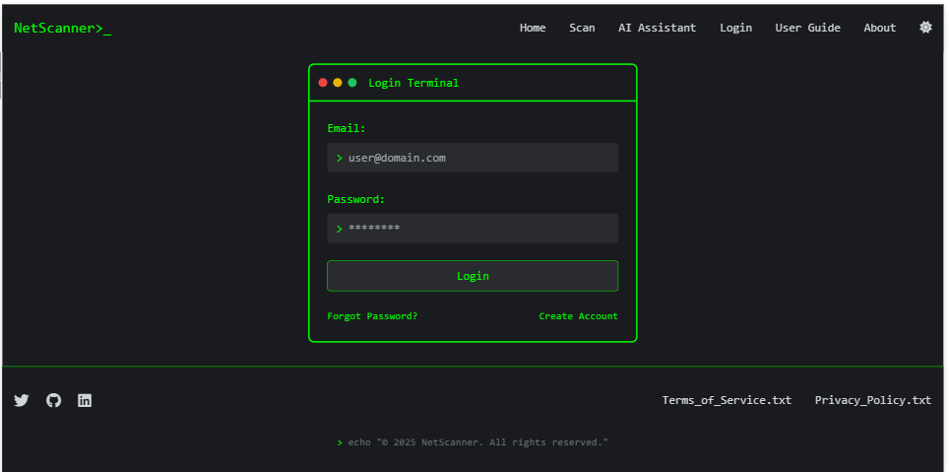
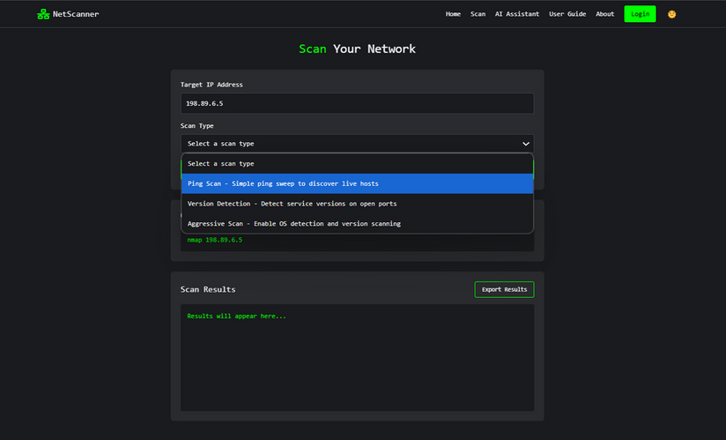
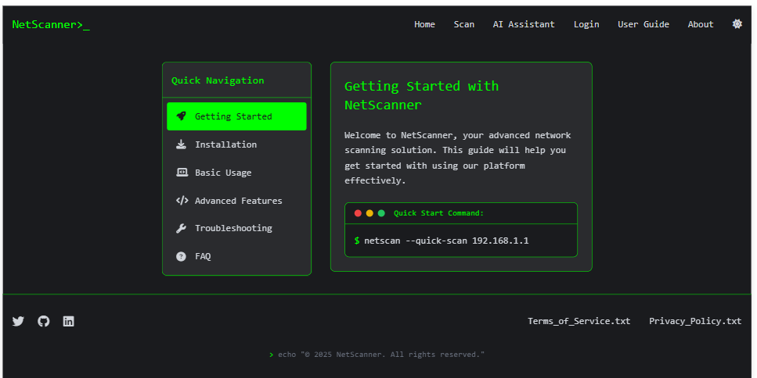
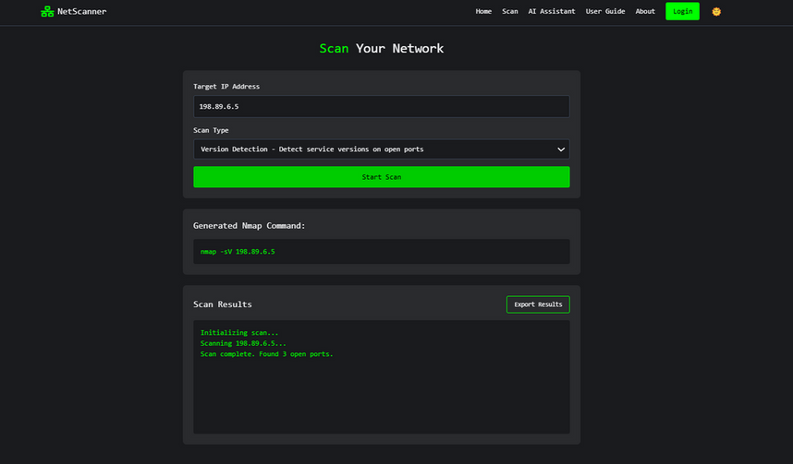
Fig 3.1.3
Fig 3.1.4
Fig 3.1.5
7
25/01/2025
Fig 3.1.6

Slide 9
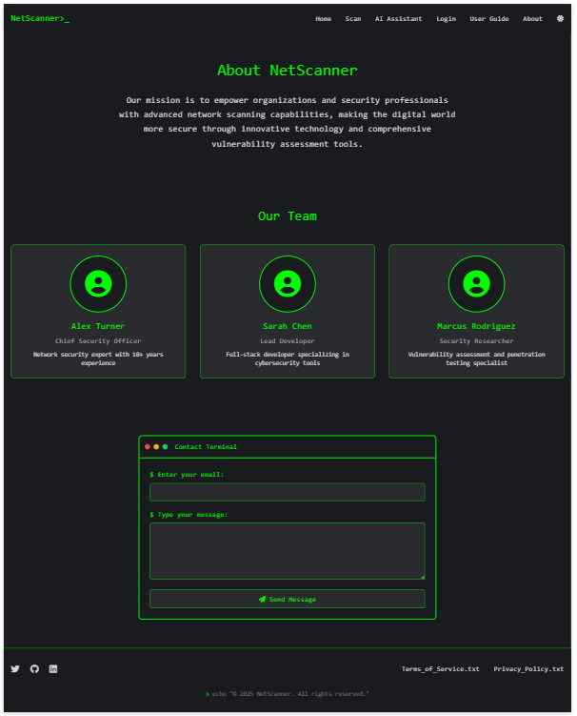
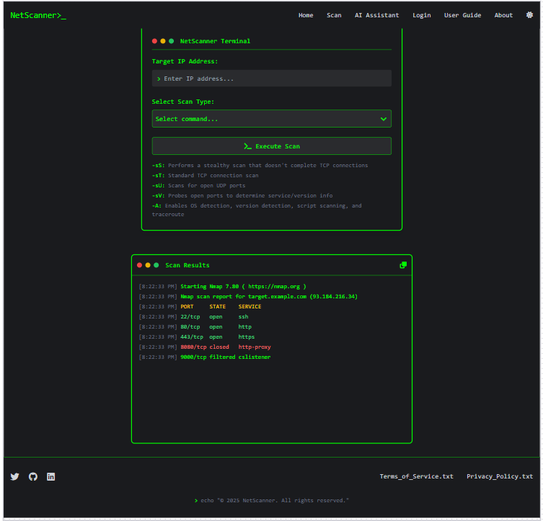
About Page
Scan Result
Fig 3.1.7
Fig 3.1.8
8
25/01/2025

Slide 10
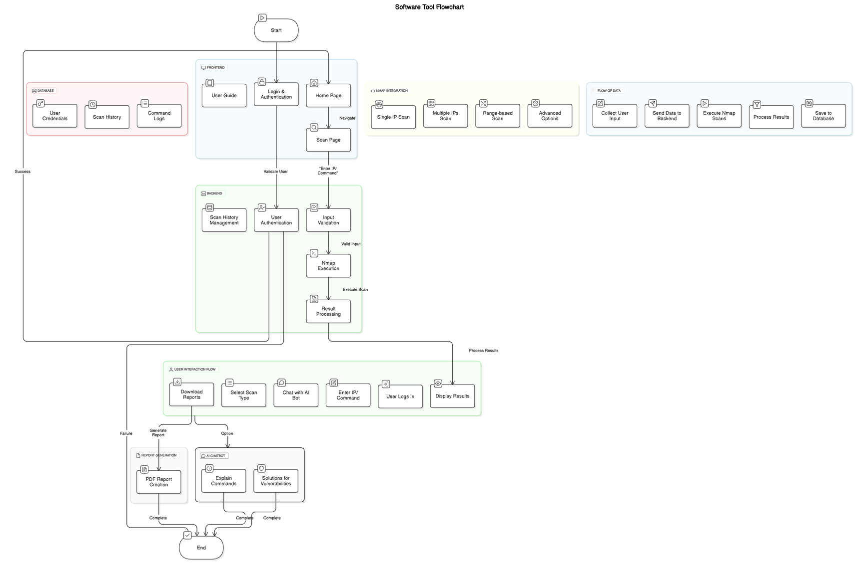

4.WorkFlow Diagram
Tech Stack Used:
9
Fig 4.1
Fig 4.2
25/01/2025

Slide 11

5.EMPATHY MAP
FEEL
SEE
Frustration with command-line tools, need for simpler options.
Anxious about making mistakes with command syntax or choosing the wrong options.
User-friendly interface with clear instructions.
Long and unclear outputs that require manual interpretation.
Limited visibility of progress while the scan is running.
SAY
DO
“I wish there was an easier way to run a network scan.”
“I’m not sure how to read the results of the scan.”
“I need something simpler and faster to use for everyday tasks.”
“Can’t I just do this through a browser?”
Input an IP range and review the results easily.
Struggles with typing complex commands accurately.
Copy-pastes commands and reuses them to avoid errors.
Avoids using Nmap or similar tools due to fear of mistakes.
Frequently uses online guides to understand how to use scanning tools.
10
25/01/2025

Slide 12
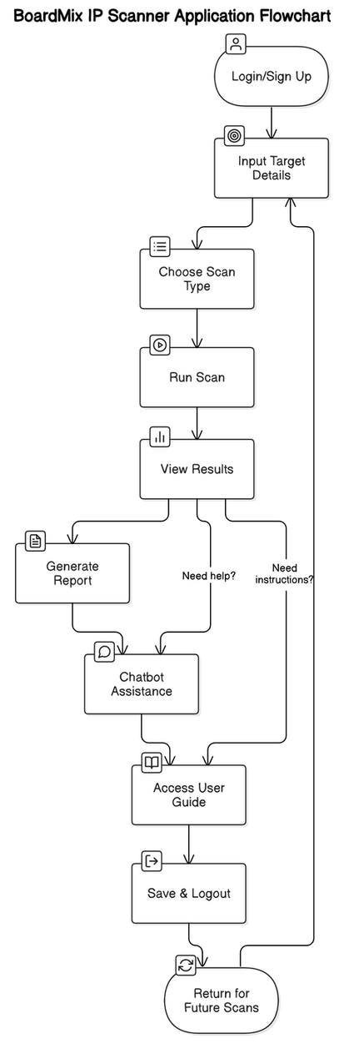
5.1 USER JOURNEY ANALYSIS
Login/Sign Up : User logs in or creates an account.
Input Target Details : User enters an IP address, range, or multiple IPs to scan.
Choose Scan Type : User selects a scan command from a dropdown menu with simple descriptions.
Run Scan : User starts the scan and sees real-time progress.
View Results : Scan results are displayed in an easy-to-read format (tables or charts).
Generate Report : User downloads results as a PDF or CSV report.
Chatbot Assistance : AI chatbot helps with scan results or questions.
Access User Guide : User refers to the guide for step-by-step instructions if needed.
Save & Logout : Scan history is saved, and the user logs out.
Return for Future Scans : User can check past scans and perform new ones.
11
25/01/2025
Fig 5.1

Slide 13
5.2 Key Takeaways
Positive Insights
User-Friendly Interface: Simplified design makes scanning intuitive and accessible, even for non-experts.
Real-Time Progress: Live updates during scans enhance transparency.
Report Generation: Easy export of results in PDF/CSV formats adds value for documentation.
AI Chatbot Integration: Provides instant guidance for understanding results or fixing vulnerabilities.
Customization: Users can choose specific scan types and commands based on their needs.
Limitations
Limited Advanced Features: May not cater to expert users who require extensive customization.
Performance on Large Scans: Scanning very large IP ranges could take significant time.
Dependency on Internet Connectivity: Certain features, like the chatbot or updates, require a stable internet connection.
Opportunities for Improvement
Enhanced Performance: Optimize scan speeds for larger IP ranges.
Advanced Options: Include an expert mode for detailed custom scans.
Offline Functionality: Allow basic scans and result storage without internet access.
Mobile Compatibility: Develop a mobile-friendly version for on-the-go use.
Integration with Other Tools: Enable seamless data sharing with other cybersecurity or monitoring platforms.
13
25/01/2025

Slide 14
THANK YOU
14
25/01/2025

